Slide 1
Web Application

Slide 2

Web Application Development
A web application or web app is any software that runs in a web browser.
It is created in a browser supported programming language(such as the combination of JavaScript, HTML and CSS) and relies on a web browser to render the application.
Web application development is the process and practice of developing web applications.
Technologies
HTML
ASP.NET
PHP
JavaScript
Ajax etc……

Slide 3
What is HTML?
HTML is a markup language for describing web documents (web pages).
HTML stands for Hyper Text Markup Language
A markup language is a set of markup tags HTML documents are described by HTML tags
Each HTML tag describes different document content

Slide 4
HTML Versions
Version | Year
HTML | 1991
HTML+ | 1993
HTML 2.0 | 1995
HTML 3.2 | 1997
HTML 4.01 | 1999
XHTML | 2000
HTML5 | 2012

Slide 5
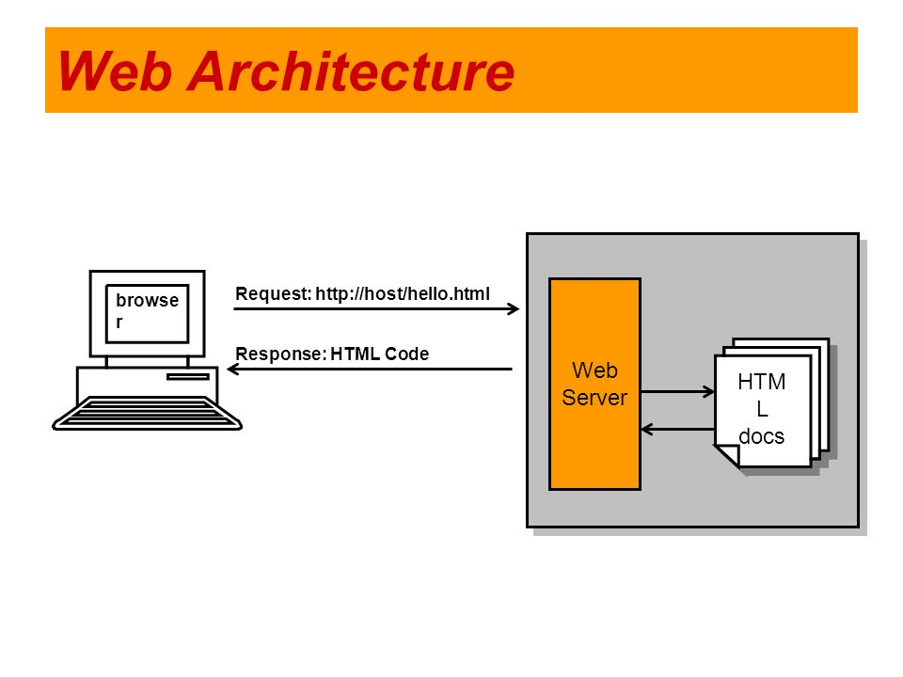

Slide 6
Simple Example
<!DOCTYPE html> <html> <body> <h1>My First Heading</h1> <p>My first paragraph.</p> </body> </html>

Slide 7
Description
The DOCTYPE declaration defines the document type
The <!DOCTYPE> declaration helps the browser to display a web page correctly.
There are many different documents on the web, and a browser can only display an HTML page correctly if it knows the HTML version and type.
The doctype declaration is not case sensitive. All these are acceptable:
<!DOCTYPE html> <!DOCTYPE HTML> <!doctype html> <!doctype HTML>
The text between <html> and </html> describes the web document
The text between <body> and </body> describes the visible page content
The text between <h1> and </h1> describes a heading
The text between <p> and </p> describes paragraph

Slide 8
HTML Tags
HTML tags are keywords (tag names) surrounded by angle brackets:
<tagname>content</tagname>
HTML tags normally come in pairs like <p> and </p>
The first tag in a pair is the start tag, the second tag is the end tag
The end tag is written like the start tag, but with a slash before the tag name

Slide 9
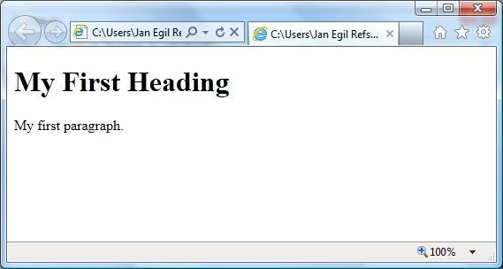
Web Browsers
The purpose of a web browser (Chrome, IE, Firefox, Safari) is to read HTML documents and display them.
The browser does not display the HTML tags, but uses them to determine how to display the document:

Slide 10
HTML Page Structure
<html>
<body>
<h1>This is a heading</h1>
<p>This is a paragraph.</p>
<p>This is another paragraph.</p>
</body>
</html>

Slide 11
HTML Editors
Write HTML Using Notepad or TextEdit
HTML can be edited by using a professional HTML editor like:
Adobe Dreamweaver
Microsoft Expression Web
CoffeeCup HTML Editor
However, for learning HTML we recommend a text editor like Notepad (PC) or TextEdit (Mac).

Slide 12
Follow the 4 steps below to create your first web page with Notepad.
Step 1: Open Notepad
To open Notepad in Windows 7 or earlier:
Click Start (bottom left on your screen). Click All Programs. Click Accessories. Click Notepad.
To open Notepad in Windows 8 or later:
Open the Start Screen (the window symbol at the bottom left on your screen). Type Notepad.

Slide 13
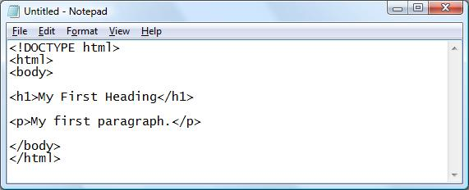
Step 2: Write Some HTML
Write or copy some HTML into Notepad.
Example
<!DOCTYPE html> <html> <body> <h1>My First Heading</h1> <p>My first paragraph.</p> </body> </html>

Slide 14
Step 3: Save the HTML Page
Save the file on your computer.
Select File -> Save as in the Notepad menu.
When saving an HTML file, use either the .htm or the .html file extension. There is no difference, it is entirely up to you.

Slide 15
Step 4: View HTML Page in Your Browser
Double-click your saved HTML file, and the result will look much like this:

Slide 16
HTML Headings
HTML headings are defined with the <h1> to <h6> tags
<!DOCTYPE html>
<html>
<body>
<h1>This is heading 1</h1>
<h2>This is heading 2</h2>
<h3>This is heading 3</h3>
<h4>This is heading 4</h4>
<h5>This is heading 5</h5>
<h6>This is heading 6</h6>
</body>
</html>

Slide 17
HTML Links
HTML links are defined with the <a> tag:
Example
<a href="http://www.google.com">This is a link</a>
<!DOCTYPE html> <html> <body> <a href="http://www.google.com">This is a link</a> </body> </html>
The link address is specified in the href attribute.

Slide 18
HTML Images
HTML images are defined with the <img> tag.
The source file (src), alternative text (alt), and size (width and height) are provided as attributes:
Example
<img src=“image.jpg" alt=“google.com" width="104" height="142">
<!DOCTYPE html> <html> <body> <img src=“image.jpg" alt=“google.com" width="104" height="142"> </body> </html>

Slide 19
HTML Attributes
HTML elements can have attributes
Attributes provide additional information about an element
Attributes are always specified in the start tag
Attributes come in name/value pairs like: name="value"

Slide 20
The lang Attribute
The document language can be declared in the <html> tag.
The language is declared in the lang attribute.
Declaring a language is important for accessibility applications (screen readers) and search engines:
Example
<!DOCTYPE html> <html lang="en-US"> <body> <h1>My First Heading</h1> <p>My first paragraph.</p> </body> </html>
The first two letters specify the language (en). If there is a dialect, use two more letters (US).

Slide 21
The title Attribute
HTML paragraphs are defined with the <p> tag.
In this example, the <p> element has a title attribute. The value of the attribute is "About W3Schools":
Example
<p title="About W3Schools"> W3Schools is a web developer's site. It provides tutorials and references covering many aspects of web programming, including HTML, CSS, JavaScript, XML, SQL, PHP, ASP, etc. </p>

Slide 22
Others
The href Attribute
<a href="http://www.w3schools.com">This is a link</a>
Size Attributes
HTML images are defined with the <img> tag.
The filename of the source (src), and the size of the image (width and height) are all provided as attributes:
<img src="w3schools.jpg" width="104" height="142">

Slide 23
HTML Table
The HTML tables allow web authors to arrange data like text, images, links, other tables, etc. into rows and columns of cells.
The HTML tables are created using the <table> tag in which the <tr> tag is used to create table rows and <td> tag is used to create data cells.

Slide 24
Example
<!DOCTYPE html>
<html>
<head>
<title>HTML Tables</title>
</head>
<body>
<table border="1">
<tr>
<td>Row 1, Column 1</td>
<td>Row 1, Column 2</td>
</tr>
<tr>
<td>Row 2, Column 1</td>
<td>Row 2, Column 2</td>
</tr>
</table>
</body>
</html>
Row 1, Column 1 | Row 1, Column 2
Row 2, Column 1 | Row 2, Column 2

Slide 25
Continue..
Here border is an attribute of <table> tag and it is used to put a border across all the cells. If you do not need a border then you can use border="0".
Table Heading
Table heading can be defined using <th> tag.
Cellpadding and Cellspacing Attributes
There are two attribiutes called cellpadding and cellspacing which you will use to adjust the white space in your table cells. The cellspacing attribute defines the width of the border, while cellpadding represents the distance between cell borders and the content within a cell.

Slide 26
Tables Backgrounds
You can set table background using one of the following two ways:
bgcolor attribute - You can set background color for whole table or just for one cell.
background attribute - You can set background image for whole table or just for one cell.
You can also set border color also using bordercolor attribute.

Slide 27
Table Caption
The caption tag will serve as a title or explanation for the table and it shows up at the top of the table. This tag is deprecated in newer version of HTML/XHTML.
<!DOCTYPE html>
<html>
<head>
<title>HTML Table Caption</title>
</head>
<body>
<table border="1" width="100%">
<caption>This is the caption</caption>
<tr>
<td>row 1, column 1</td><td>row 1, column 2</td>
</tr>
<tr>
<td>row 2, column 1</td><td>row 2, column 2</td>
</tr>
</table>
</body>
</html>

